Slide 1
Unencrypted Communication Standard Update 10/26/2020

Slide 2
Objective
Review the update to the ”Transmission of Sensitive Information” standard, including the exception to the standard for unencrypted communication.
Identify how requests for utilization of unencrypted communication can be made for human subject research
Review consent form changes and processes in relation to unencrypted communications.
Answer questions the research community may have

Slide 3
Standard Requirements
Standard
Protected Health Information (PHI) and other Sensitive Information (SI) (data classified as Tier 2 or Tier 3 in the UNC-Chapel Hill Information Classification Standard) that is transmitted on behalf of the University by any Constituent must be encrypted in accordance with this Standard. This means either a secure connection (VPN, HTTPS, SFTP, etc.) between each endpoint or encryption of the file/information, unless an exception applies.

Slide 4
Exception
Transmission of Sensitive Information is exempted from this Standard if documented consent is obtained from the subject of the SI or someone with authority to consent on their behalf (e.g. patient or research subject consent). Other security controls, IRB or other research requirements, or privacy requirements may apply in your specific situation. This Standard does not take the place of guidance from those authorities.

Slide 5
Examples of unencrypted vs encrypted communication
Encrypted | Unencrypted
E-mails using the “Secure” functionality | E-mails not using the “Secure” functionality
“Messages” through an encrypted/secure platform | Direct SMS messages, e.g. cell phone to cell phone

Slide 6
Required Elements of Consent
A formal consent document is required that includes at least the following elements:
Name of the consenting individual (additional relevant information if consent is on behalf of another person such as a child)
Information about the responsible unit/study/individual/clinic clearly identifying the area involved
If the form must be used as part of a medical record, key identifier such as study participant ID or patient ID (note, SSN is not an appropriate identifier for this type of documentation!)
Phone or email address to which consented communication will be sent,
A description of the authorization and its purpose including a general description of the communication content involved
A clear indication that consent is informed, including unambiguous description that the content will not be encrypted or otherwise protected
Any selections appropriate to the situation, if options about what communications content will or will not be allowed.
An unambiguous attestation that the individual consents, that they understand the risks, and that their consent is voluntary (participation in the study or other activity may not be contingent upon consent! Note, this does not apply if the study is intended to examine communication methods.)
The right to revoke authorization, which must be respected
Any applicable constraints (liability release, risks, applicable time periods…)
Authentication that the document is provided by the individual it purports to be from. Unless a wet-ink signature or its equivalent is required by another authority, any University-accepted method of authenticating a form is appropriate.
Note: at all times, transmitting only the minimum necessary information is required.

Slide 7
What is minimum necessary/what can I text or email through unencrypted communication?
Appointment Reminders
Requests/Reminders to Complete Study Activities
Requests for participants to contact study team members through encrypted means

Slide 8
What can I not text or email through unencrypted communication?
Results of testing or clinical outcomes
Recruitment for studies
Communications with minors/children
Other messaging that is not considered minimally necessary.

Slide 9
How do I obtain consent?
Submit a modification or select in initial application.
Select “Unencrypted Messaging with Participants
“Consent Addendum for Unencrypted Communication” will now be a required document type.
Required for all studies, as participants cell# or email may change and must be reconsented.
New Studies
Language in consent builder
Existing Studies
Update your existing consent with new language, if still in use/preferred.

Slide 10
Selection in IRBIS

Slide 11
Children

Slide 12
Consent Form Language (Option 1)
How will information about you be protected?
Include one of the statements below if your study will utilize unencrypted messaging (e.g., unencrypted e-mail or text messaging].
[Option 1-Most Common] The study team would like to message you by (insert technology(ies); e.g. text messaging or e-mail), however you may say “no” to receiving these messages and still participate in this study. If you say “yes”, messages may contain personal information about you and may be sent or received by the study team’s personal electronic devices or in a method that is not able to be encrypted (protected) and there is the risk your information could be shared beyond you and the study team. This information may include information such as reminders and notifications to contact the study team.
If you wish to stop receiving unprotected communication from the study team or have lost access to your device, please notify the study team using the study contact information on the first page of this consent form. After the study is complete and all research activities finished, or you withdraw from the study or request to stop receiving unprotected communication, you will no longer receive un-encrypted (un-protected)messages specific to this study.
_____ Yes, I consent to the study team utilizing the following (insert mechanism; e.g. cell phone number, email) to send communication: _(List e-mail, cell-phone #)__________
_____ No, I do not consent to receive un-protected communication from the study team.

Slide 13
Consent Form Language (Option 2)
How will information about you be protected?
Include one of the statements below if your study will utilize unencrypted messaging (e.g., unencrypted e-mail or text messaging].
[Option 2-Only for Study’s Designed to Investigate Messaging] As the purpose of this research is to study (insert technology(ies)), by signing this consent on the last page of this form you are giving permission for the study team to contact by the mechanism identified below that you provide. This communication may contain personal information about you and may be sent or received by the study team member’s personal electronic devices or in a method that is not able to be encrypted (protected) and there is the risk your information could be shared beyond you and the study team.
This information may include information such as reminders and notification requests to contact the study team. If you do not want to receive un-protected communication that may contain personal information, then you should not consent to participate in this study.
If you have lost access to your device, please notify the study team using the study contact information on the first page of this consent form. After the study is complete and all research activities concluded, or you withdraw from the study, you will no longer receive un-encrypted (un-protected) communication specific to this study.
The study team may use the following (insert mechanism; e.g. cell phone number, email) to send communication: _(List e-mail, cell-phone #)__________

Slide 14
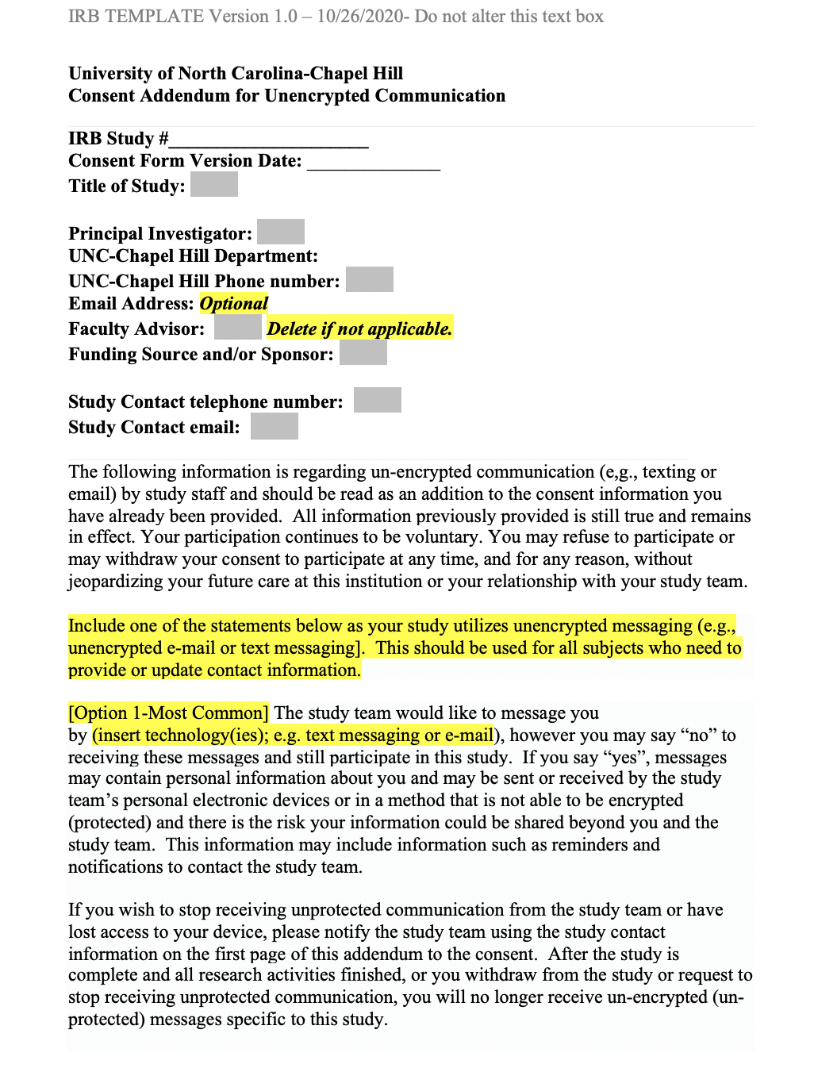
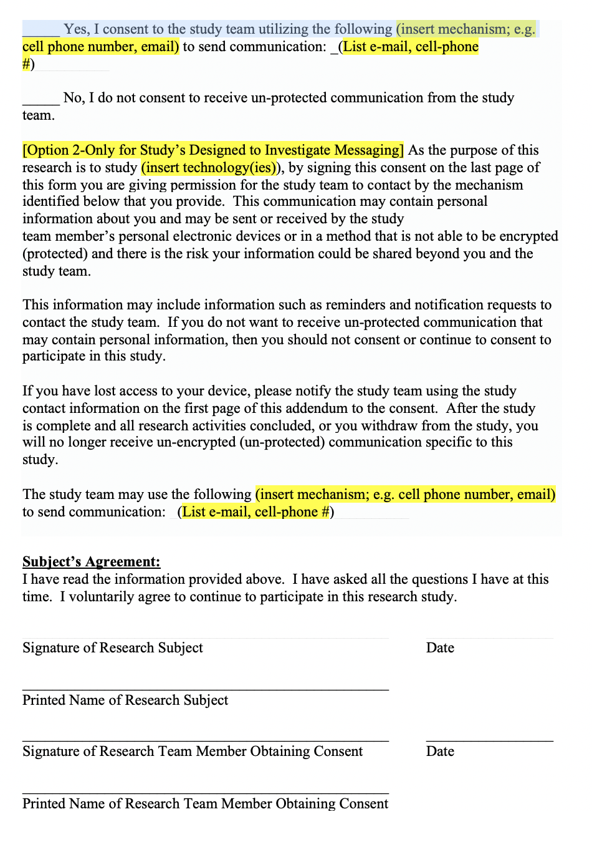
Consent Form Addendum

Slide 15
What if my project’s texting needs do not fit into this framework?
If your project’s texting needs do not fit into this framework, please seek consultation with your IT liaison and the OHRE.
As a reminder, the update to this standard does not “undo” previous assessments made by IT, and if your platform was determined to be acceptable, this standard does not alter or change this.

Slide 16
Resources
Transmission of Sensitive Information Standard
OHRE Unencrypted Communication FAQ’s
Consent Form/Addendum
IT Liaisons & OHRE Staff

