Slide 1
OHRE Update-COVID 19
6/1/2020
Cassandra Myers– OHRE Director
John Roberts- Associate Director, Regulatory Affairs & Compliance
Mike Matamoros– Associate Director, Operations and Education

Slide 2
Objectives
Reminders related to COVID
Review the OHRE announcement sent out on 5/25/2020
  COVID Information Sheet
  COVID Information Sheet Approval Letter
  Alterations to the COVID Information Sheet
Remote Consent Options
  FDA e-Consent

Slide 3
OVCR’s 5/23/2020 Announcement
On June 1, on-campus research operations and facilities will increase up to 50% of capacity.
  Determined by individual schools and the College of Arts & Sciences
  E.g., SOM Clinical Research Review Committee
Restrictions will be loosened or tightened in the weeks and months ahead based on advice of public health experts.
Research will no longer be restricted to specifically approved “critical research activities,” and forms for that purpose will no longer need to be submitted to the OVCR.
All research that can effectively be done remotely should continue to be conducted remotely and not be conducted on campus for reasons of health and safety.
OVCR’s 5/23/2020 Announcement
OVCR’s 5/23/2020 Guidance for All On-Campus Research

Slide 4
REMINDERS
Whenever possible, studies that were modified to conduct study visits/procedures via virtual/phone/remote formats need to continue to conduct procedures as modified.
Studies being submitted to the IRB for initial approval should include virtual/phone/remote formats for as many procedures as possible.
For paused studies, when possible please modify some or all face-to-face procedures to virtual/phone/remote formats prior to re-starting the study.
Ensure all research staff have knowledge of and adherence to each department’s plan to appropriately increase volume and OVCR’s guidance.

Slide 5
What was sent in the OHRE Announcement
COVID Information Sheet
  Already approved by the IRB.
  Must be used verbatim unless otherwise approved study by study.
  Only customization allowed under approval is where ‘XXX’s’ have been placed
  Working on an international version with additional ‘XXX’s with UNC’s ID department, will be shared broadly
COVID Information Sheet Approval Letter
  Place in general study file with other IRB approval documentation
Remote Consent Tables
Modification COVID Tables

Slide 6
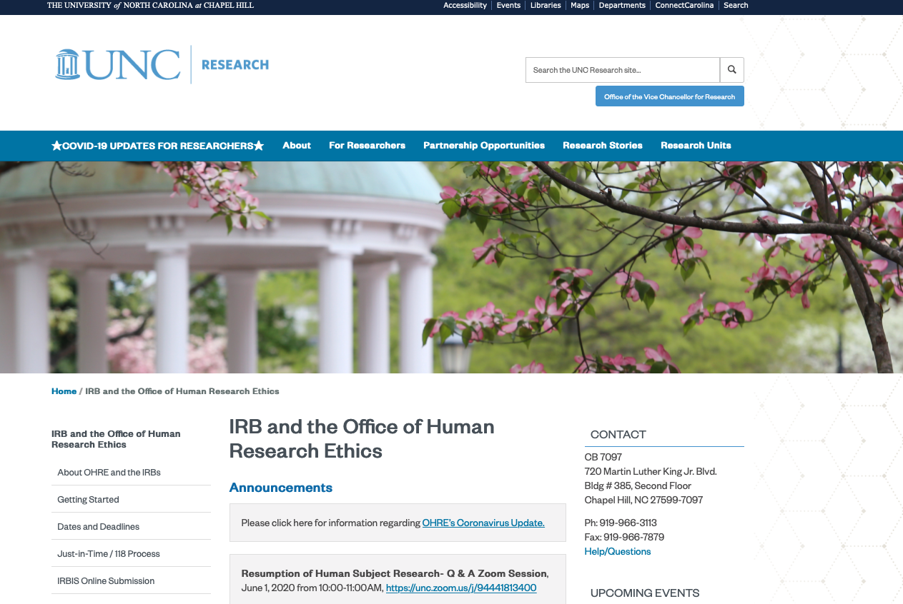
Where do I find the OHRE COVID Update and Information Sheet?

Slide 7
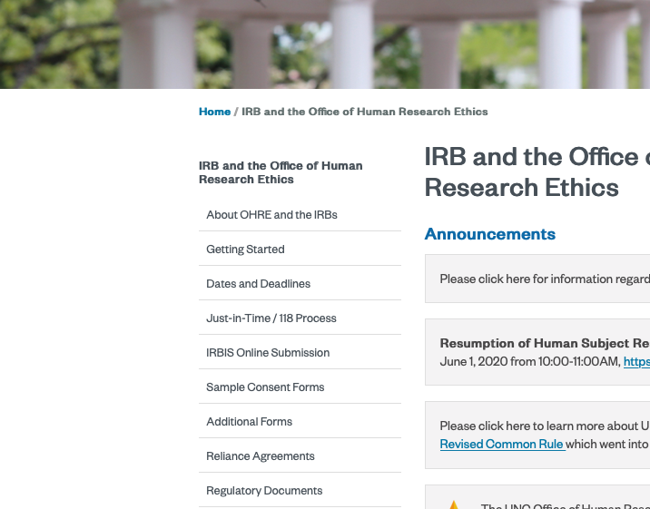
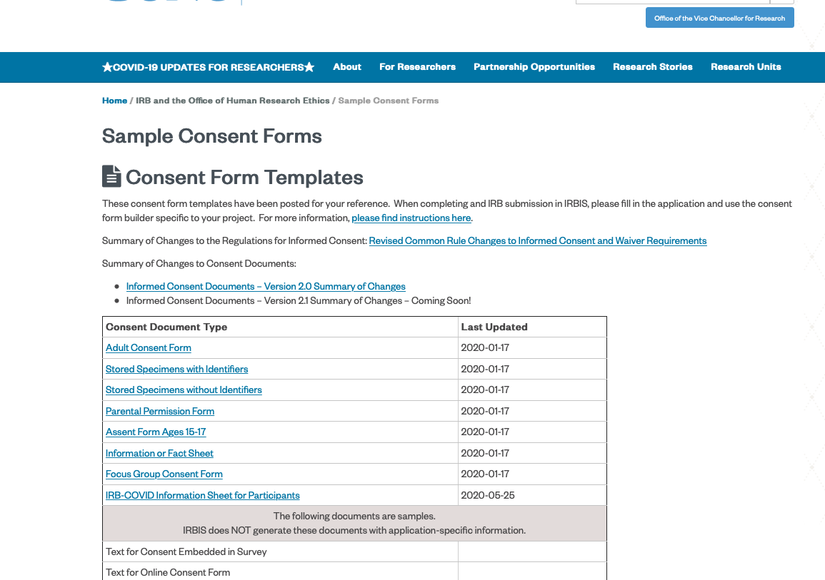
Where do I find the OHRE COVID Information Sheet?

Slide 8
How do I get my research started/restarted from the IRB?
Identify and employ the mechanism your department/school is utilizing for the 50% resumption. If part of the 50% resumption proceed.
Review the guidelines sent by the OVCR’s office.
Review the OHRE COVID Information Sheet
If any changes to #2, #3, or any other procedures create a modification.

Slide 9
How do I get my research started/restarted from the IRB?
1. We want to resume research as of 6/1/2020
1.a. Do you have department/School approval?
1.b Cannot Proceed at This Time
No
2 & 3. Are you able to follow
-OVCR’s Guidance
-COVID Information Sheet and no other changes to approved IRB?
Yes
3.b/ 4.d Resumption of Research Activities
No
4. Submit a Modification to the IRB
4.c Must wait for approval
No
4.b Modification approved?
Yes

Slide 10
Why the COVID Information Sheet?
The IRB is responsible for ensuring that the 111 criteria are met and that subjects are appropriately informed of the risks and the risk mitigation strategy (OVCR’s guidance). By approving the information sheet and issuing the approval letter, the IRB is approving the modification to all studies that have face to face interactions.
This information sheet was developed with Infectious Disease expertise, external IRB consultation, and review by several board members and the OVCR’s office.
If the UNC OHRE IRB did not utilize the OVCR’s policy and guidance developed with our Infectious Disease experts as a standard than we would need to review every study for resumption as well as individual risk mitigation plans
This is new territory for all, and other IRB’s and institutions may choose to do these processes differently.

Slide 11
For whom do I use the COVID Information Sheet?
For all subjects who have face to face interactions for research purposes should utilize the COVID Information Sheet:
  Does not need to be at every visit, once is generally sufficient
  Does not need to be signed, however the conversation with participant’s, the risk analysis for subject by subject continuation, and the outcome of the discussion should be documented in the subject’s research record.
    Each subject should be assessed if they are in a high-risk group and documented in the research record the risk to benefit discussion.
  Does not apply if the enrollment in research is due to a COVID diagnosis and treatment.

Slide 12
When do I use the COVID Information Sheet?
  If possible, please call subjects and discuss with them verbally as coming into a clinic, a research area, or building and meeting research personnel could carry risk. As a reminder these do not need to be signed and verbal is sufficient when documented in the research record
  For subjects already enrolled: at the next contact point, as you will be calling them the day before to confirm this would be an excellent time to review.
  For prospective subjects: at the time of consent or before any screening activities occur.

Slide 13
What if I need changes to the COVID Information Sheet?
The approval letter was written for all studies and why there must be restrictions around alterations and requirements for modifications.
If you need any changes outside of customization of the “XXX”s then it will need to be reviewed and approved on a study by study basis as the OHRE will need to assess the risk to benefit.
    The OHRE is working with ID to create an international version that allows for a few minor additional XXXX’s and will be issued a second approval letter.
The submission must include in the modification description a risk analysis for any changes to the Information Sheet or where OVCR’s guidance will not be followed.

Slide 14
Multi-Site Research
As each institution will have institutional requirements due to local laws, regulations, and requirements this may require a study by study evaluation by the study team.
If the research is being conducted by UNC researchers - as the policy and guidance is institution-wide the COVID Information Sheet should be used regardless of location, unless otherwise approved.
  e.g., international studies, studies reviewed by commercial IRB’s
  If your study has oversight at other institutions, please also confirm with them regarding processes
If another site is conducting face to face interactions, and relies on UNC’s IRB, they may choose to use our Information Sheet, provide us with another to review, or submit why it is not applicable.

Slide 15
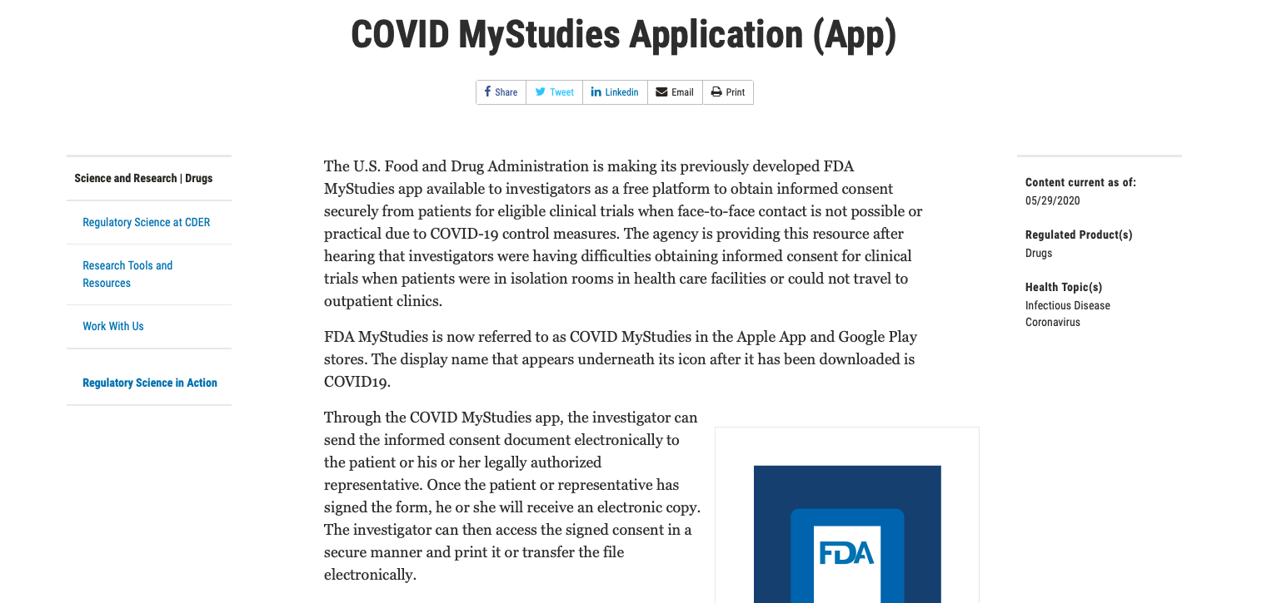
FDA-COVID MyStudies Application
This new application has been made available for free from the FDA to utilize for “E-consent”, it has been sent to Privacy and IT for an evaluation to see if it can be used at UNC.
Please do not utilize until IT and Privacy have had the opportunity to appropriately assess.

Slide 16
Consent Processes-IRB
Please refer to "Consenting Study Subjects in Isolation and Documentation " slides;
Please remember some of this is dependent upon the risk level of the study (minimal risk/greater than minimal risk) and if its FDA regulated.
Risk Level/Regulations | Full Waiver of HIPAA and Consent | Alt. Or Waiver of Signature (Verbal) | Signature is Required
Minimal Risk-No Intervention/Interaction with subjects *Expedited Categories | Yes | Likely NA | Likely NA
Minimal Risk- Intervention/interaction with subjects *Expedited Categories | Likely NA | Yes | If possible, (for electronic consider Qualtrics, REDCap or other IT approved mechanism)
Greater than minimal risk- Full board | NA | NA | Yes (for electronic signature consider Qualtrics, REDCap or other IT approved mechanism)
Greater than minimal risk-Full Board FDA Regulated | NA | NA | Yes (for electronic signature must be Part 11 Compliance, check with IT Liaison)

Slide 17
What if the IRB has not approved my submission for COVID changes?
  Please refer to the OHRE website and the COVID FAQ's:
  As a reminder, initiating research or modifications to research without IRB approval is permitted to eliminate apparent immediate hazards to the human subjects per DHHS OHRP and FDA regulations.
  Please submit the modification as soon as available.
  If you need to "alter your procedures" to remove immediate risk of harm, these should be noted in your deviation log and submitted to the IRB as an NSI if they meet the criteria outline in SOP 1401. Please note your sponsors and monitors are going to want to see analysis of risk in the deviation log.

Slide 18
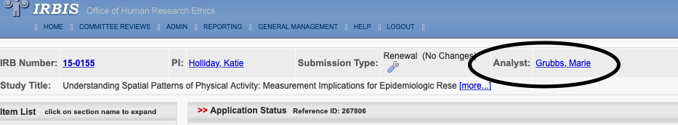
Are the OHRE/IRB returning to campus on 6/1/2020?
The OHRE and IRB have continued to review during this time period
  Since 3/13/2020, finalized over 5700 submissions, 700 modifications related to COVID, and over 95 new COVID related studies.
  To help reserve PPE for our researchers and subjects the OHRE will continue to work remotely and hold board meetings via Zoom.
  Staff are available via email and voice messages left will be returned within 1 working day as much as possible, as the staff have virtual voicemail.
  Assigned staff can be identified in IRBIS by accessing the study specific submission:

Slide 19
  General Questions 919-966-3113|
    irb_questions@unc.edu
  Cassandra (Cassie) Myers, OHRE Director
    Cassandra.myers@unc.edu
  John Roberts, Associate Director Regulatory Affairs & Compliance
    jtr@unc.edu
  Mike Matamoros, Associate Director Operations & Education
    matamoro@email.unc.edu

