Slide 1
IRB Reliance Agreements
John Roberts, CIP
Associate Director of Regulatory Affairs & Compliance

Slide 2
IRB Reliance Agreements
Formal document that provides a mechanism for an institution engaged in research to delegate IRB review to an independent IRB or an IRB of another institution, or accept primary review responsibilities regarding the research on behalf other institutions or individuals.
Used when non-exempt human subjects research is conducted at multiple sites, when a participating research entity does not have its own IRB, or when the research requires specialized IRB expertise.
Expected benefits include reduction in duplication and variation, decrease in activation time, and foster collaboration between sites.
Adapted from: http://www.niaid.nih.gov/LabsAndResources/resources/toolkit/Pages/faq.aspx

Slide 3
OHRP Federalwide Assurance (FWA)
Documents an institution’s commitment to comply with federal regulations governing human subjects research.
Covers all research supported or conducted research involving human subjects
**Requires written formal agreement of compliance from all non-affiliated investigators
Notes:
In addition maintaining compliance with federal regulations, the terms of the FWA also include having written IRB procedures, IRB review of all non-exempt research covered by the FWA, obtaining and documenting informed consent unless waived, ensuring that all collaborating institutions operate under an approved FWA and that the institution agrees to provide sufficient resources for IRB operations.

Slide 4
Requirements in UNC’s FWA (#4801)
The institution bears full responsibility for ensuring that all human subject research is conducted in accordance with Federal regulations.
The IRB must review and approve or disapprove research involving human subjects according to guidelines set forth in 45 CFR 46.
The investigators acknowledge and accept their responsibility for protecting the rights and welfare of human subjects and for complying with the FWA.
NOTE: Without an FWA, Federally Funded research can not be conducted at an institution. An FWA can be cancelled by the Office for the Protection of Human Subjects (OHRP)!

Slide 5
4 Types of Agreements
IAA: IRB authorization agreements (e.g., UNC relies on Duke IRB, Wake Forest relies on UNC IRB; can be executed between institutions when both have an FWA) ←→
IIA: Independent Investigator Agreements (e.g., Bob Smith relies on UNC IRB; typically consultants, subcontractors, former students; UNC IRB extends our FWA to a small non-profit that does not have an FWA) →
Central or Commercial IRB Agreements: IAAs (e.g., UNC relies on WIRB, UNC relies on the NCI CIRB; at UNC, ‘central IRB’ typically refers to a commercial IRB or NCI CIRB) →
Broad Agreements: IAAs (e.g. the joint NCSU/UNC biomedical engineering dept, EPA relies on UNC IRB for all HSR reviews) →

Slide 6
UNCs most common agreements when providing regulatory oversight
UNC’s IRB Authorization Agreement (IAA) template may be used when both parties have a Federal Wide Assurance (FWA).
Smart IRB Authorization Agreement may be used when both parties have an FWA and are Smart IRB Participating Institutions.
UNC Individual Investigator Agreement (IIA Institutional) is used when the external group or organization does NOT have a Federal Wide Assurance (FWA)
UNC Individual Investigator Agreement (IIA Individual) is used when an Independent Investigator will be covered by the UNC IRB.

Slide 7
Independent Investigators
When a collaborator outside of UNC-CH is not acting as an employee of another group or organization with respect to their involvement in the research, they may be considered an Independent Investigator. Typically independent investigators are volunteers, recent graduates or former staff who are no longer affiliated with UNC, or independent consultants contracted to work on the research. In order to be considered an independent investigator, this person is required to complete an ‘Independent Investigator Confirmation Form’

Slide 8
Multi-Site Study Information
An Independent Investigator Confirmation Form is required for all individuals lacking a primary appointment at another institution, when UNC IRB will be providing oversight.
The form includes the following statement:
I confirm that my collaboration on the above referenced research project is independent of any other organization or institution as I am: (a) not otherwise an employee or agent of an assured (i.e., FWA holding) institution*, and
(b) not acting as an employee of any organization or institution with respect to my involvement in the research being conducted by UNC, and
(c) not using the collaboration for scholarly advancement (e.g., promotion, tenure) at an organization or institution.

Slide 9
Multi-Site Study Information cont.
This table is from the reliance guidance document and indicates who is covered by UNC IRB, and allowed to serve as Principal Investigator
UNC Affiliation | Covered by UNC IRB? If ‘No’, a reliance agreement is required. | Allowed to serve as PI?
Adjunct Faculty who hold primary appointments at other institutions or organizations. Please note that some UNC faculty also hold adjunct appointments in another UNC department in addition to their primary appointment. | No | No
Visiting Scholars (hold primary appointments at other academic or research institutions) | No | No
Emeritus Faculty (Retirees) | No | No, but may continue to serve as PI on studies that are in data analysis only
Faculty, other (Professor, Associate Professor, Assistant Professor, Instructor, Lecturer, Teaching Professor, Clinical Professor, Research Professor) | Yes | Yes
Retirees | No | No
EHRA Non Faculty, including Post-Doctoral Fellows | Yes | Yes, but Post-Doctoral Fellows are required to have a faculty advisor
SHRA Employees | Yes | No
SHRA Temporary Employees | Yes | No
Vendors/contractors | No | No
Volunteers | No | No
Interns (who are not UNC Students) | No | No
UNC Students (Graduate and Undergraduate Students, Interns) | Yes | Yes, faculty advisor must be identified
Fogarty Global Health Fellows (UNC Institute for Global Health & Infectious Diseases) | Yes | Yes, faculty advisor must be identified. A faculty advisor is not required on a reliance application.

Slide 10
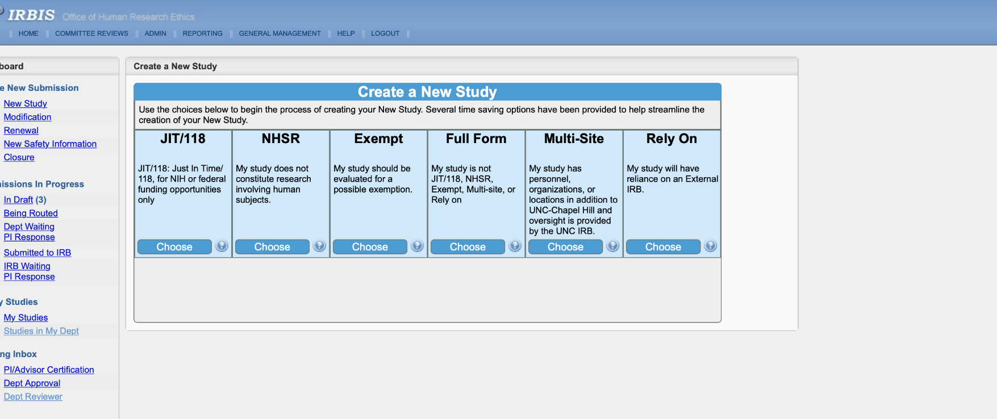
Process for Requesting a Reliance Agreement
Guidance documents are located on the OHRE website here: http://research.unc.edu/human-research-ethics/reliance/
NOTE: updates to guidance coming
All requests for reliance agreements are submitted through IRBIS.

Slide 11
UNC is the IRB of Record for Others

Slide 12
UNC is relying on another IRB
If the intent is to rely on another IRB for review (cede review):

Slide 13
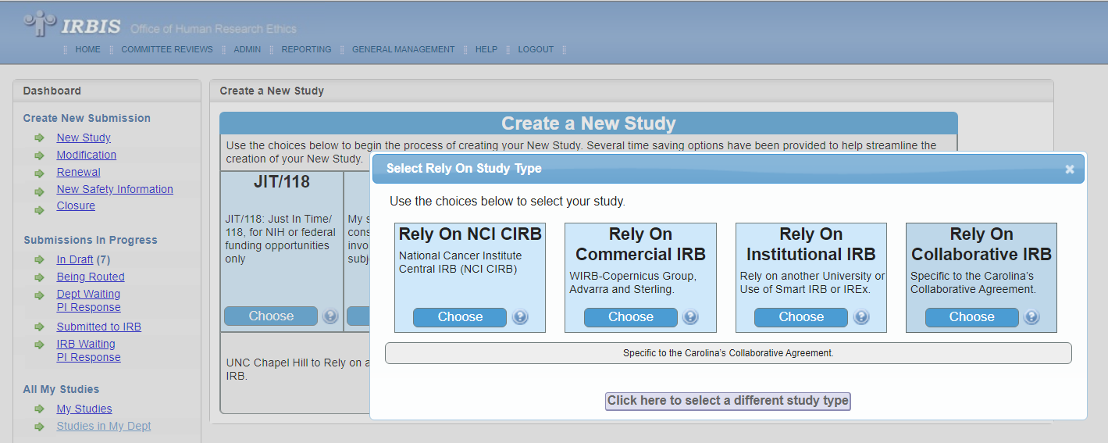
UNC is relying on another IRB
Select appropriate reviewing IRB type:

Slide 14
Multi-Site Study Information cont.
Both pathways (accept review for others, or cede review) require additional information to be provided. May include:
Name of other institution,
Description of the role of collaborators,
Full legal name of collaborating institutions,
Contact Information
Template Consent Form
*Contact the collaborating institutions IRB to obtain the most accurate information for the collaborating institution

Slide 15
Relying on Commercial IRBs
Required for all industry sponsored multi-site clinical trials, unless exception by OHRE Director or Associate Director is given.
UNC has MSA’s with:
WIRB
Advarra
Sterling
Must obtain Permission to Register from UNC OHRE through IRBIS before submitting to commercial IRB, a Cover Letter will be provided with UNC rules.

Slide 16
Commercial IRB Submission Req.
Initial Submission for Permission to Register​ in IRBIS
External IRB approval letter (with date of expiration) for the overall study/protocol* ​
Master Protocol ​
Sponsor's Model Consent Forms ​
UNC Standalone HIPAA Authorization form (if applicable)​
Recruitment materials, only for MyChart/Join the Conquest/Research for Me ​
Documentation of any applicable ancillary review, as well as any resulting language requirements (IDS, radiation safety, PRC, IBC, etc) ​
Documentation of the approved Subject Injury Language from OIC/Chris Nelson ​
Completed Conflict of interest Review:The standard UNC process for COI disclosure still applies. Registration with the Commercial IRB cannot occur until the UNC COI process has been completed for all applicable members of the research team. ​
Confirmation of required ethics training for all UNC personnel​
*If the commercial IRB is acting as a single IRB of record then the approval letter can be provided. If UNC is a standalone site there will be no existing approval letter and can be noted in the IRBIS Submission​

Slide 17
Broad Agreements
Executed to provide IRB coverage for multiple protocols, when the collaborator and reviewing IRB have special arrangements, typically to accommodate substantial collaborations.
Environmental Protection Agency (EPA) – UNC IRB is the IRB of record for the EPAs HSR, has broad agreement to cover EPA research conducted at EPA facilities on campus, as well as other EPA/UNC collaborations.

Slide 18
NIH Single IRB Review Mandate
Effective January 25, 2018
For applications with due dates on or after January 25, 2018, and contract solicitations published on or after January 25, 2018, NIH expects that all sites participating in multi-site studies, which involve non-exempt human subjects research funded by the NIH, will use a single Institutional Review Board (sIRB) to conduct the ethical review required for the protection of human subjects.
This policy applies to the domestic sites of NIH-funded multi-site studies where each site will conduct the same protocol involving non-exempt human subjects research. It does not apply to career development, research training or fellowship awards. Implementation of the NIH sIRB policy is expected to reduce unnecessary administrative burdens and systemic inefficiencies while maintaining appropriate human subjects protections.
Applicants will be expected to include a plan for the use of a sIRB in the grant applications and contract proposals they submit to the NIH (for due dates on or after January 25, 2018).

Slide 19
NIH Single IRB Review Mandate
https://smartirb.org/
Currently 700+ Participating Institutions, all 64 CTSA hubs
Smart IRB: a platform designed to ease common challenges associated with initiating multisite research and to provide a roadmap for institutions to implement the NIH Single IRB Review policy
Smart IRB Agreement: a standardized reliance agreement, does not require negotiating of agreement terms, may be cited for multisite collaborative arrangements sponsored by any funding type
Reviewing IRB = IRB of Record = Lead IRB = sIRB
Relying Institution = participating site ceding review

Slide 20
NIH Single IRB Review Mandate
NOTES:
Investigators who intend to cede review to another institution (sIRB, commerical IRB, etc) still require an application in IRBIS. UNC IRB will conduct a review of UNC personnel (ethics trainings & COI disclosures) since participating sites will follow their own institutional policies regarding ethics trainings and conflicts of interest (COI).
Local context will be provided by the UNC IRB pertaining to ancillary reviews (radiation safety, biosafety, etc) and any relevant institutional policies or concerns regarding specific research protocols at the time of review, including customization of the consent form to be used at UNC.
UNC Researchers should always use the separate standalone HIPAA authorization, and not a combined consent & HIPAA

Slide 21
What is considered Local Context?
Examples Include:
UNC COI Office Review
UNC CITI Requirements
Ancillary Reviews (Radiation Safety, Biosafety, etc)
NC Mandatory Reporting Requirements
Age of Majority-NC State Law
HIPAA Authorization Form

Slide 22
IRB Contacts for Reliance Agreements: http://research.unc.edu/human-research-ethics/reliance/ OHRE main line 919-966-3113
For questions about commercial IRBs:
Sarah Phelan or Jason Zeller
For questions about all other reliance agreements:
IRBReliance@unc.edu or
John Roberts jtr@unc.edu

